Slide 1

Minesweeper game in java
Ade Kurniawan
Rafi Fajar Sulaiman
Angga Pranindiya

Slide 2
What Is Minesweeper
Minesweeper is a computer game for one player. The object of the game is to clear the playing field without hitting mines. The game is played by opening squares on the grid, usually by clicking on the mouse. If the opened box contains mines, the player loses. A square containing a number indicates the number of mines around it. Players can right click to mark the box with mines. in this game the first step in starting the game is to choose a grid size, after that in the next step we are asked to choose the level of difficulty that exists such as easy, medium, and hard

Slide 3

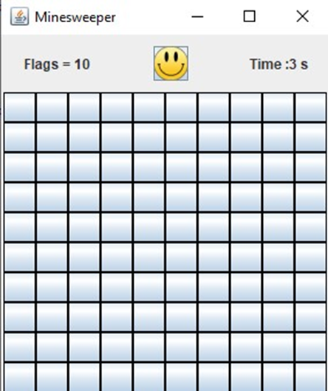
Choose GridSize
gridsize selection can be set manually by the user, for example in this example the user selects 10 grids in the minesweeper game. it means that in the game there are 10x10 total rows and columns used in playing minesweeper

Slide 4
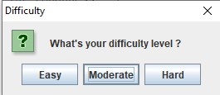
Game Mode
in minesweeper there are 3 choices of difficulty levels that users can choose freely. The difference between each level of difficulty is how many traps there are randomly in the columns. The higher the difficulty level, the more traps there are in the column

Slide 5
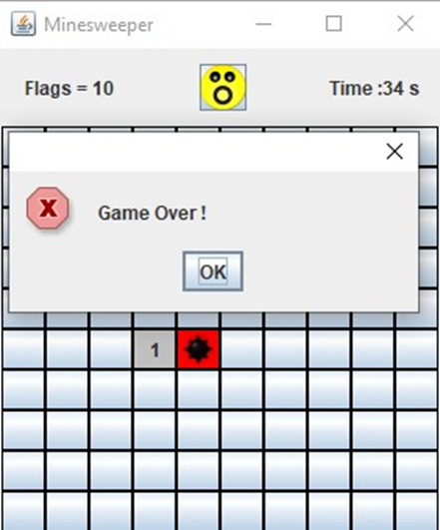
Gameplay
then after selecting the grid and the level of difficulty then we can run the game by clicking on the available columns and avoiding the appearance of bombs in order to continue to maintain the game. The display is successful if we don't hit any of the bombs that are randomly found in these columns. if we hit the bomb it's game over.

Slide 6
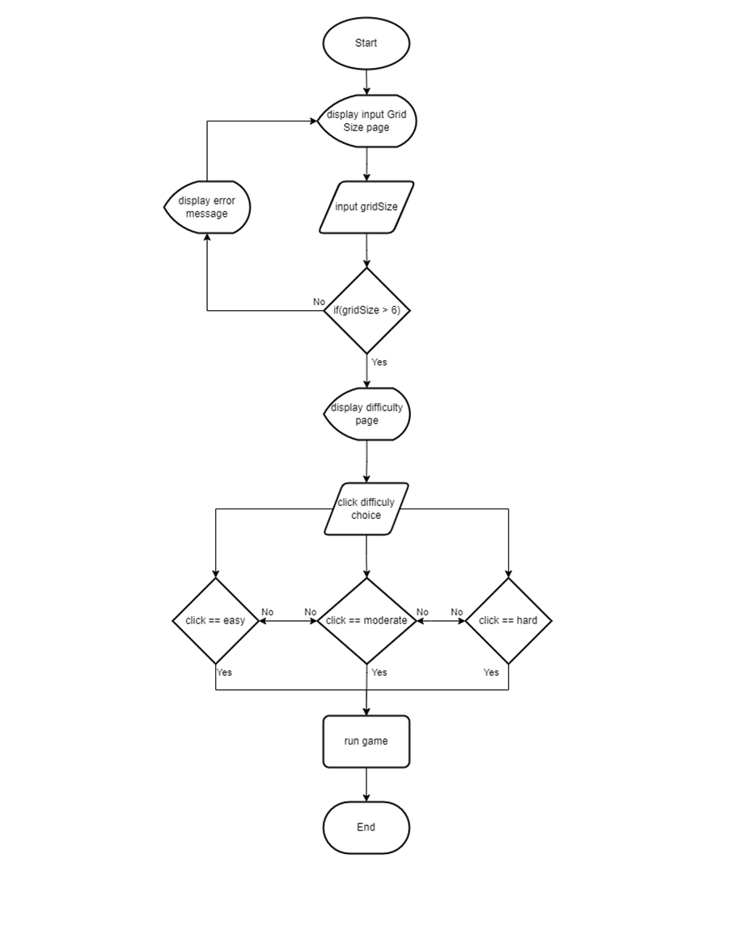
FLOWCHART
this is a flowchart display from the minesweeper game which contains the following.
start> display gridsize input panel> input gridsize > conditional if(gridsize > 6) NO> display error message > balik ke step 1 YES> display Difficulty Panel> input (actionlistener) choice> conditional if(choice == "Easy")> runs the game in easy mode> if moderate> moderate mode> if hard> hard mode

Slide 7
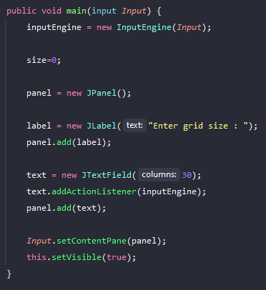
CODE
Displaying The First Frame Panel (Input Grid Size)

Slide 8
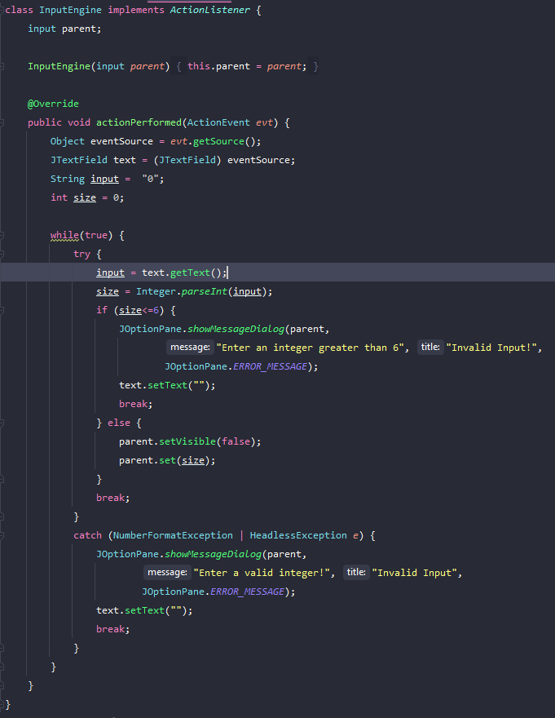
CODE
Displaying The First Frame Panel (Input Grid Size) Error Message

Slide 9
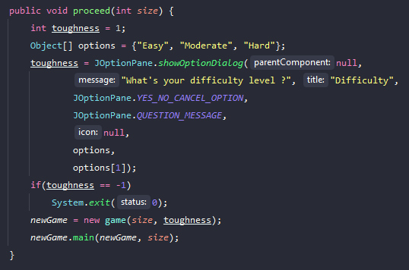
CODE
Displaying the 2nd panel (choose difficulty)

Slide 10
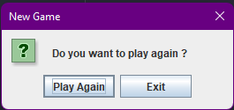
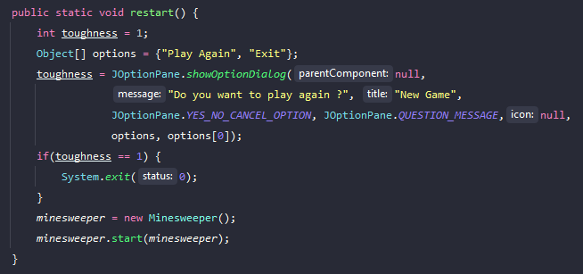
CODE
Displaying the last panel (for restarting the game)

Slide 11
Thank you

